Slide 1




SpeeDT
CEF 440 : PROGRAMMING AND MOBILE PROGRAMMING
A Quality of Experience Mobile Network Monitoring Application for
Mobile Network Subscribers in Cameroon
Task 7: Final Project Presentation
GROUP 4
Course Instructor Dr. Nkemeni Valery
University of Buea Faculty of Engineering and Technology

Slide 2






Table of Contents
01
02
Problem & Motivation
Requirements & Design
The QoE gap and what our survey revealed
From verified findings to functional specs
03
04
System Architecture
Implementation
Three-tier design, database and data flow
Frontend, backend and the working app
05
06
Results & Evaluation
Conclusion & Future Work
What we achieved, and what remains open
Contribution, roadmap and the team
SpeeDT · CEF440 Task 7
2

Slide 3



01
Problem & Motivation
Why mobile network Quality of Experience needed a dedicated tool in Cameroon

Slide 4


01 · PROBLEM & MOTIVATION
A Real Problem, Felt Every Day
The Context
The Problem
Mobile connectivity now underpins learning, mobile money and everyday communication in Cameroon. Operators run their own internal monitoring, but ordinary subscribers have no simple way to see their own connection quality, record it over time, or say how it actually feels to use.
Slow speeds, weak signal, dropped connections and instability are noticed only when something important fails.
Users have no objective evidence of quality at the moment of failure — blame falls arbitrarily on device, app, bundle or operator.
Existing apps (OpenSignal, Network Cell Info, Speedtest) offer pieces of this, but none combines accessibility, passive monitoring, personal history and transparent, user-controlled privacy — grounded in Cameroonian subscriber concerns.
SpeeDT targets Quality of Experience (QoE), not just Quality of Service (QoS) — how the connection performs technically and how it actually feels to the person using it.
SpeeDT · CEF440 Task 7
4

Slide 5
01 · PROBLEM & MOTIVATION
What 93 Cameroonian Subscribers Told Us
Verified, reproducible figures from a structured survey — not assumptions.
100%
93.5%
83.9%
55% / 45%
of respondents report network problems at least “sometimes” (52.7% “often”, 16.1% “always”)
want to see reports of their own network performance — a core, not optional, feature
use MTN as their primary operator, followed by Orange (9.7%) and CAMTEL (6.5%)
Android-to-iOS platform split, confirming the need for genuine cross-platform support
SpeeDT · CEF440 Task 7 Final Presentation
5

Slide 6

02
Requirements & Design
Translating verified survey findings into functional and non-functional requirements

Slide 7





02 · REQUIREMENTS & DESIGN
Core Functional Requirements
FR-01 · Background Collection
FR-02 / FR-09 · Dashboard & History
FR-03 · Quality Notifications
Best-effort automatic capture of network type, speed, latency and jitter.
Real-time quality view plus historical charts and trend statistics.
Threshold-based alerts when measured quality drops, subject to permission.
FR-05 · Subjective Feedback
FR-06 · Location-Aware Context
FR-08 · Offline Queue & Sync
Four-dimension QoE rating — overall, speed, delay, reliability — plus comments.
Generalised GPS captured only after explicit, separate user consent.
Local queuing when offline, automatic sync once connectivity returns.
Full set: FR-01 through FR-12, each traceable to a specific verified survey finding (Table 6 → Table 7).
SpeeDT · CEF440 Task 7
7

Slide 8
02 · REQUIREMENTS & DESIGN
Non-Functional Requirements & Priority
Non-Functional Requirements
CRITICAL
Consent, device identity, metric collection, local storage, sync, database storage
NFR-02 Granular consent for location, notifications and background collection — captured separately.
NFR-03 / 04 Battery- and data-efficient: lightweight passive collection, batched and Wi-Fi-restrictable uploads.
HIGH
Dashboard, history, notifications, manual speed test, backend validation
NFR-06 / 07 Reliable under poor connectivity; anonymous device identity protects subscriber privacy.
NFR-08 Layered, maintainable code with reusable modules and typed interfaces throughout.
MEDIUM / LOW
Advanced analytics, data-usage counters, heat maps, app-store release automation
SpeeDT · CEF440 Task 7
8

Slide 9

03
System Architecture
Three-tier design, relational data model and offline-first data flow

Slide 10
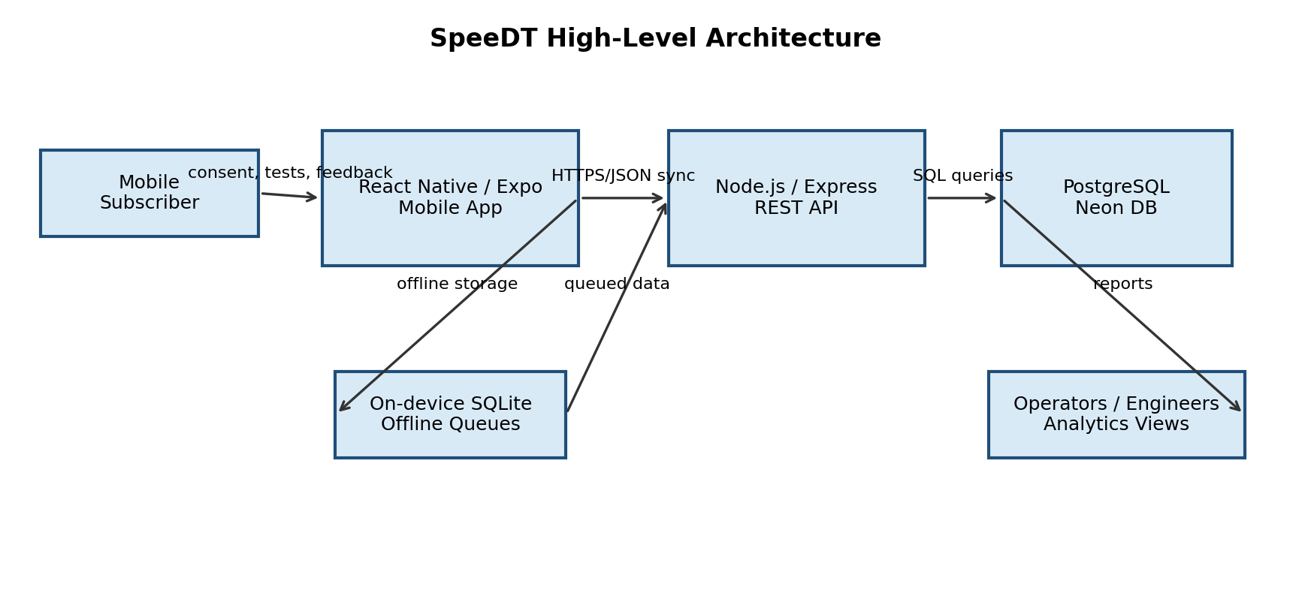


03 · SYSTEM ARCHITECTURE
A Three-Tier, Offline-Aware System
Mobile Tier
React Native / Expo app with an on-device SQLite queue for unsynchronised data.
Application Tier
Node.js / Express REST API — routes, controllers, services, middleware.
Database Tier
PostgreSQL on Neon DB stores every persistent server-side record.
SpeeDT · CEF440 Task 7
10

Slide 11
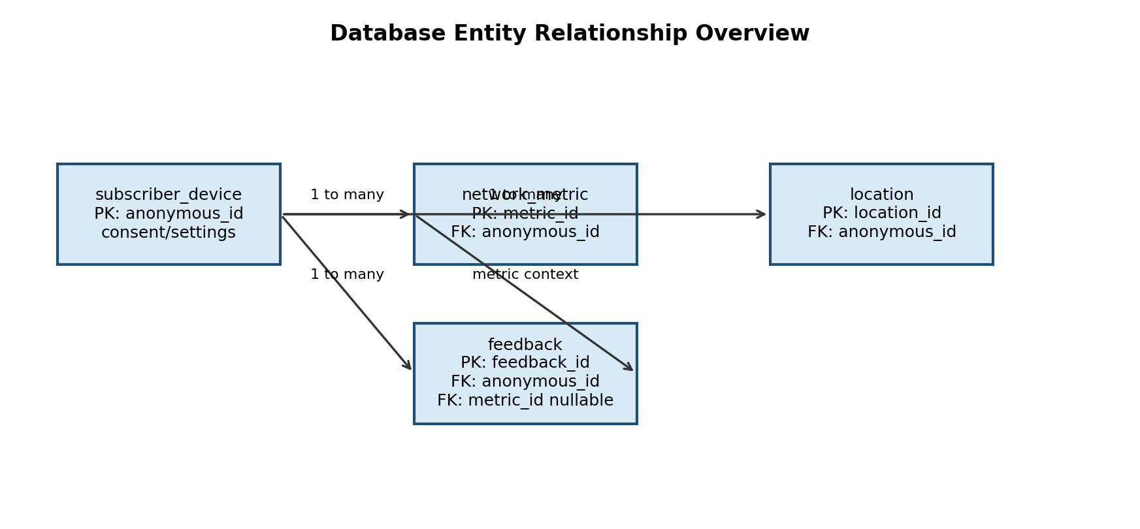
03 · SYSTEM ARCHITECTURE
Database Design — Four Core Tables
subscriber_device
Anonymous device identity, consent flags and settings.
network_metric
Objective performance readings — speed, latency, jitter, signal.
location
Generalised location context, subject to explicit consent.
feedback
Subjective QoE ratings across four dimensions, plus comments.
Foreign keys use ON DELETE CASCADE, so removing a device cleanly removes its metrics, locations and feedback.
SpeeDT · CEF440 Task 7
11

Slide 12
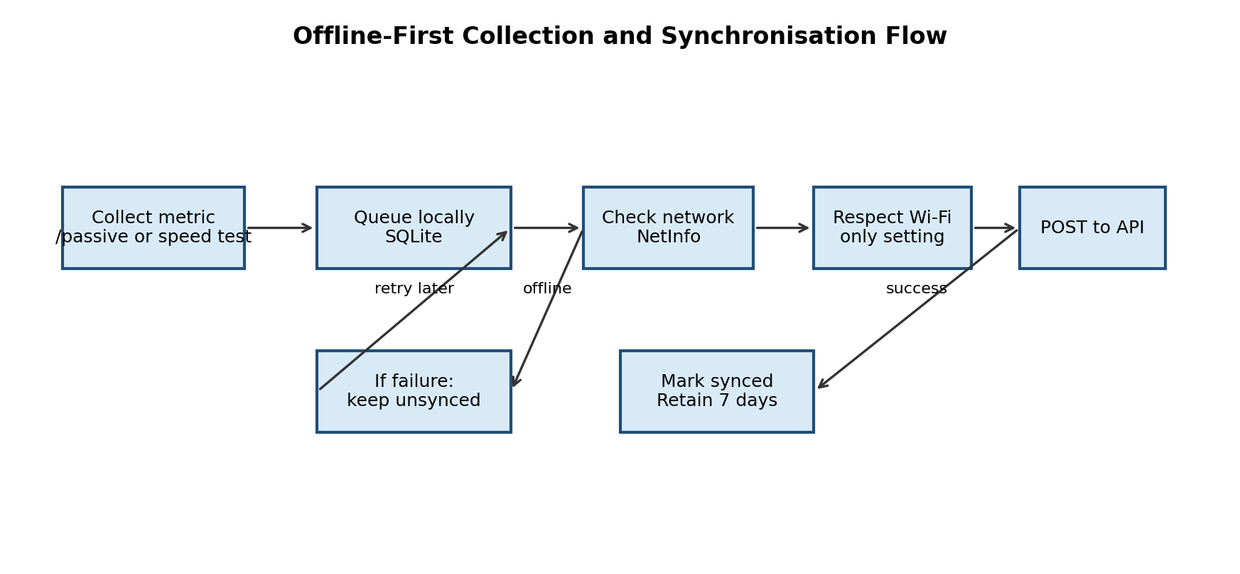
03 · SYSTEM ARCHITECTURE
Offline-First Collection & Synchronisation
Every measurement is written to a local SQLite queue with synced = 0 before any network call.
The sync module uploads unsynchronised rows once connectivity returns, marking them synced only after success.
A retention policy clears old synced rows; a Wi-Fi-only setting blocks automatic cellular uploads.
SpeeDT · CEF440 Task 7
12

Slide 13
04
Implementation
From design models to a working cross-platform mobile application

Slide 14
04 · IMPLEMENTATION
Tools, Languages & Technologies
Layer | Tools Used | Purpose
Mobile Frontend | React Native, Expo SDK, TypeScript, Expo Router | Screens, navigation, UI components and app logic
Device APIs | NetInfo, Expo Location, Notifications, Background Fetch | Network detection, GPS, alerts, best-effort background collection
Local Data Layer | Expo SQLite, Expo Secure Store | Offline queues, settings and anonymous ID persistence
Backend API | Node.js, Express.js, CORS, dotenv | REST endpoints, JSON handling, environment configuration
Database | PostgreSQL, Neon DB, node-postgres | Relational storage for devices, metrics, locations, feedback
Dev Tools | VS Code, npm, Postman, Git / GitHub | Coding, dependency management, API testing, version control
SpeeDT · CEF440 Task 7
14

Slide 15

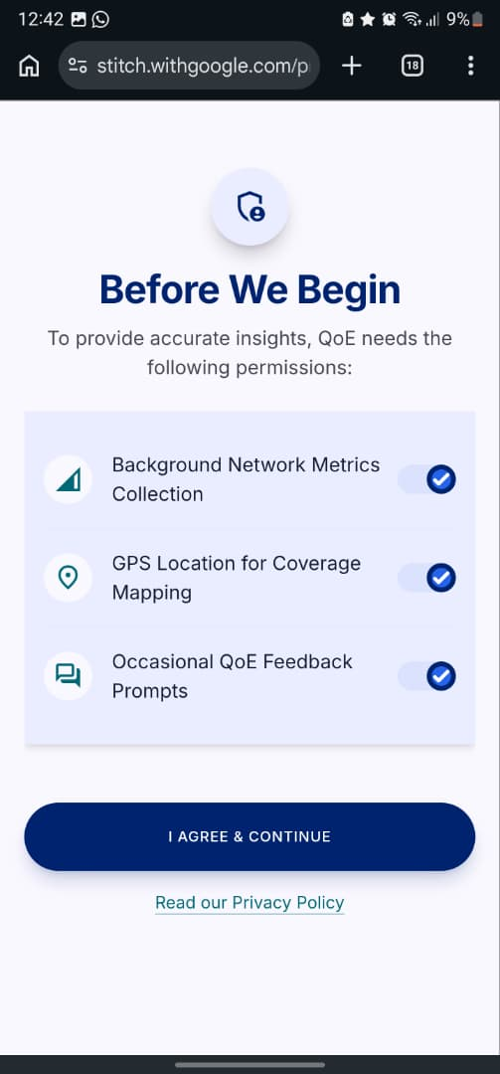
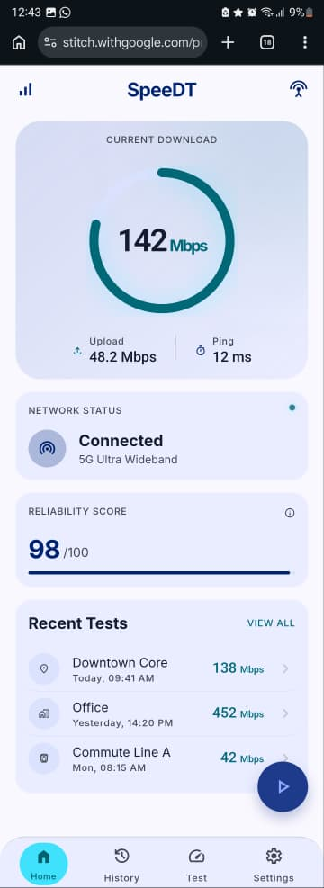
04 · IMPLEMENTATION
Onboarding, Consent & Home Dashboard
Onboarding
Granular Consent
Home Dashboard
Explains SpeeDT's purpose before any permission prompt.
Separate toggles for location, notifications and background collection.
Reads recent metrics from local storage and refreshes on focus.
SpeeDT · CEF440 Task 7
15

Slide 16
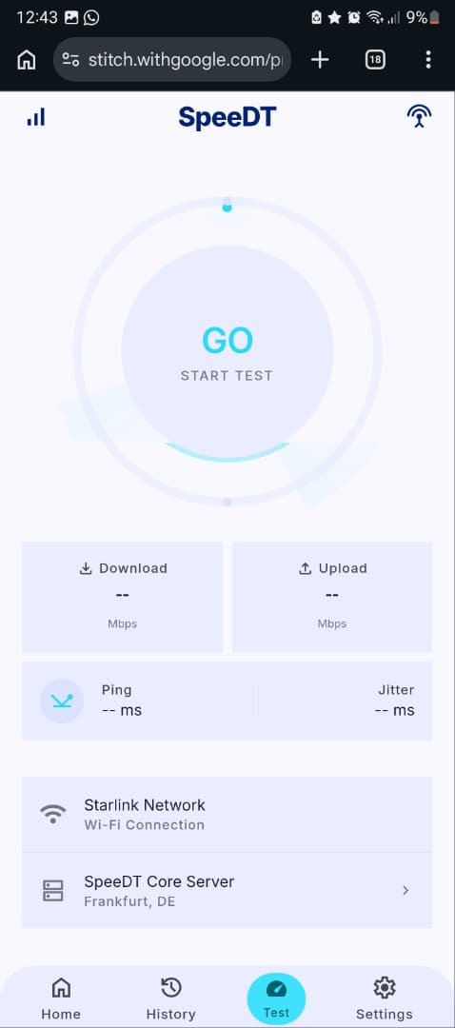
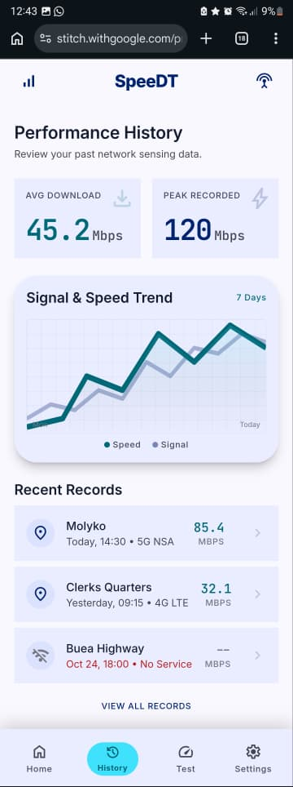
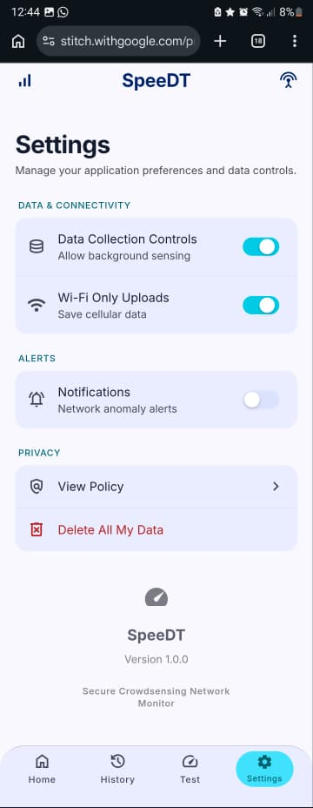
04 · IMPLEMENTATION
Speed Test, History & Settings
Speed Test
Performance History
Settings
Three sequential phases: latency, download and upload measurement.
Real trend chart plus average and peak statistics from actual readings.
Wi-Fi-only uploads, notifications and a working delete-all-data pipeline.
SpeeDT · CEF440 Task 7
16

Slide 17
04 · IMPLEMENTATION
Backend API — Key Endpoints
Method | Endpoint | Purpose
POST | /api/devices | Register a subscriber device and create an anonymous ID
PATCH | /api/devices/:id | Update consent, collection and notification settings
DELETE | /api/devices/:id | Delete a device and cascade-delete its linked data
POST | /api/metrics | Ingest a network metric record
GET | /api/metrics/latest/:id | Retrieve the latest metric for a device
POST | /api/feedback | Submit QoE feedback ratings and comment
GET | /api/analytics/average-speed/:id | Return average download and upload speeds
Full set includes device, metric, location, feedback and analytics endpoints validated with UUID and boolean-field checks.
SpeeDT · CEF440 Task 7
17

Slide 18
h
05
Results & Evaluation
An honest account of what was achieved — and what remains open

Slide 19

05 · RESULTS & EVALUATION
Achieved vs. Honest Limitations
Achieved
Honest Limitations
Cross-platform React Native/Expo app across Android and iOS
Consent, anonymous ID and working delete-all-data pipeline
Offline SQLite queue with connectivity-triggered sync
Four-dimension QoE feedback modal
Full PostgreSQL schema with cascading deletes
Device, metric, location, feedback & analytics REST endpoints
Raw cellular signal strength is unreliable on iOS without native modules
Background execution timing is controlled by the OS, not guaranteed
Speed tests use public endpoints, not dedicated regional servers
No encryption-at-rest yet for local SQLite data (needs SQLCipher)
Exact data-usage counters are platform-limited
Operator dashboards and heat maps remain future work
SpeeDT · CEF440 Task 7
19

Slide 20

h
06
Conclusion & Future Work
Contribution, recommendations, the team and next steps

Slide 21


06 · CONCLUSION & FUTURE WORK
Recommendations & Future Work
Dedicated Measurement Server
Operator Dashboard
Stronger Local Security
Deploy a SpeeDT server in or near Cameroon for accurate, repeatable speed tests.
Aggregate anonymised results into maps, charts and operator-comparison reports.
Add SQLCipher-based encryption at rest and production HTTPS with certificate pinning.
Field Testing at Scale
Richer Analytics
Production Readiness
Validate performance across multiple towns, operators and device types.
Recurring poor-quality zones, operator comparison and time-of-day patterns.
App-store deployment, a privacy policy, and hardened server configuration.
SpeeDT · CEF440 Task 7
21

Slide 22

06 · CONCLUSION & FUTURE WORK
Group 4
Ako Junior Ngoh
Etuma Elkings Bosango
Moukam Hako Bellamy Steve
Njikang Bright Ndode Ngone
Ringnyuy Mbunwe Giyoh Lemuel
FE23A008
FE23A053
FE23A096
FE23A115
FE23A136
Course Instructor: Dr. Engr. Nkemeni Valery · CEF440 Programming and Mobile Programming
SpeeDT · CEF440 Task 7
22

Slide 23


Thank You

Slide 24

Thank You

